Slide 1



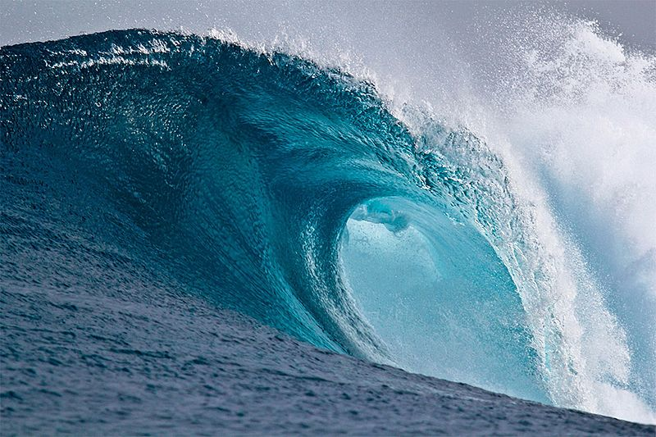

WAVES

Slide 2

Overview of waves
Waves and Sound - How do sound or light reach... - ClickView
Waves are the transfer of energy!

Slide 3
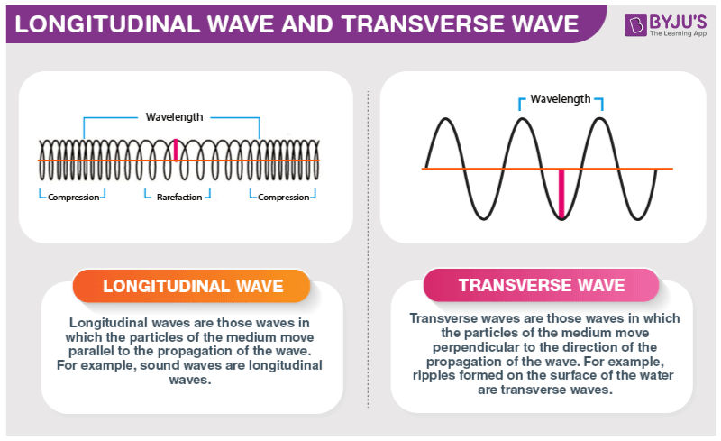
MECHANICAL WAVES require a medium to transmit energy
MECHANICAL WAVES
TRANSVERSE WAVES
LONGITUDINAL WAVES
Wave vibrates perpendicular to the direction of motion.
Wave vibrates parallel to the direction of motion.
Water waves, guitar strings.
Sound waves

Slide 4
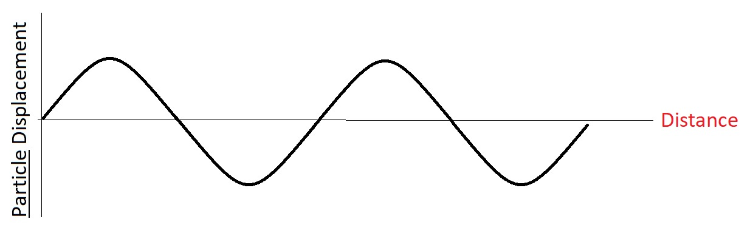
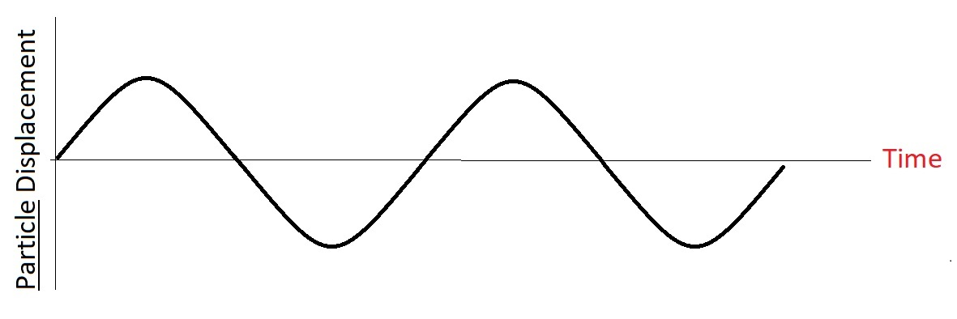
Graph Types
Note that: Displacement here refers to the displacement of
particles from rest position.
Displacement / Distance
Displacement / Time

Slide 5
Properties of Displacement / DISTANCE Graphs
Wavelength
Amplitude
Amplitude
Wavelength
The length of one complete wave cycle (before the pattern repeats)
Amplitude
The maximum displacement of particles from rest position
Frequency (f)
How many waves occur in a single second (measured in Hertz, Hz)
Wave Equation : Velocity = wavelength x frequency

Slide 6
Properties of Displacement / TIME Graphs
Period (T)
Amplitude
Amplitude
Period (T)
Time taken to complete one cycle/wavelength
(units seconds, s)
Amplitude (A)
The maximum displacement of particles from rest position
Frequency (f)
How many waves occur in a single second (measured in Hertz, Hz)
Frequency= 1/ period

Slide 7
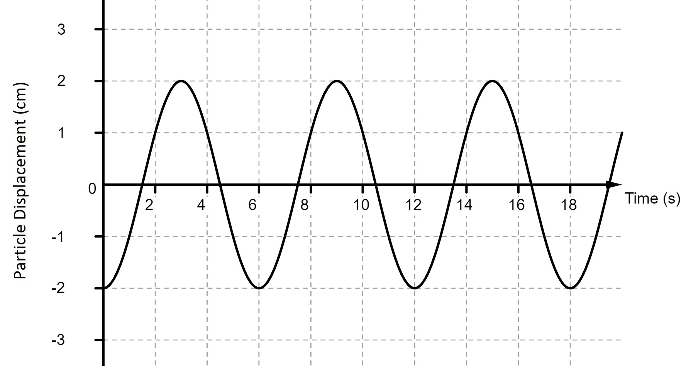
Example Question(s):
Determine:
Period(T) = ?
Amplitude = ?
Frequency(f) = ?

Slide 8
